Slide 1
Heart Disease Diagnostic Analysis
In this Project we have analyses the chance of heart attack among people of Different Ages.

Slide 2
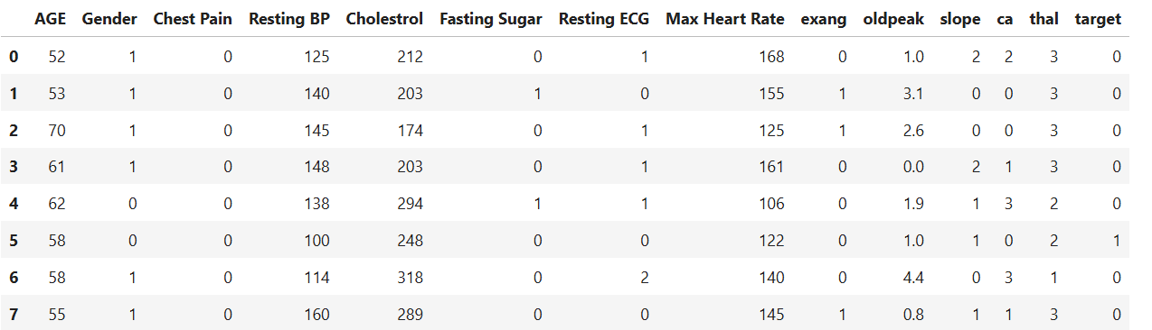
Sample View Of The Dataset

Slide 3
Dataset Details(Parameter Details
1)Age 2) Gender - Male/Female 3) Chest Pain- 4 Types of Values
4) Resting Blood Pressure 5) Cholesterol 6)Fasting Sugar 7) Resting ECG
8)Maximum Heart Rate 9)exang- Exercise induced angina
10) oldpeak - ST depression induced by exercise relative to rest
11) slope - The slope of peak exercise relative to rest
12) ca - number of major vessels(0-3)
13)thal : 0-normal, 1: fixed defect, 2: reversible defect

Slide 4
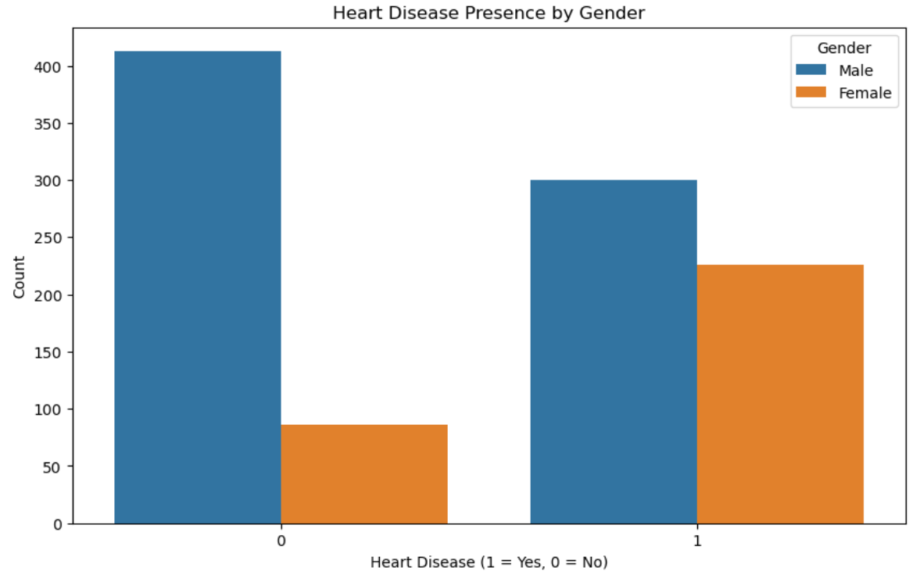
Heart Disease Presence Analysis

Slide 5
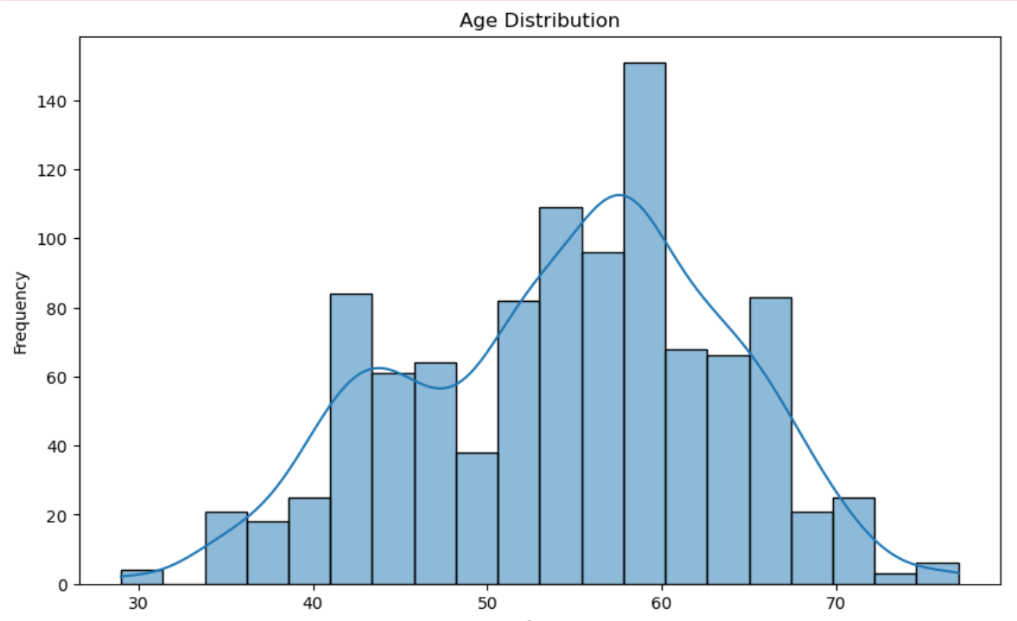
Age Distribution Analysis

Slide 6
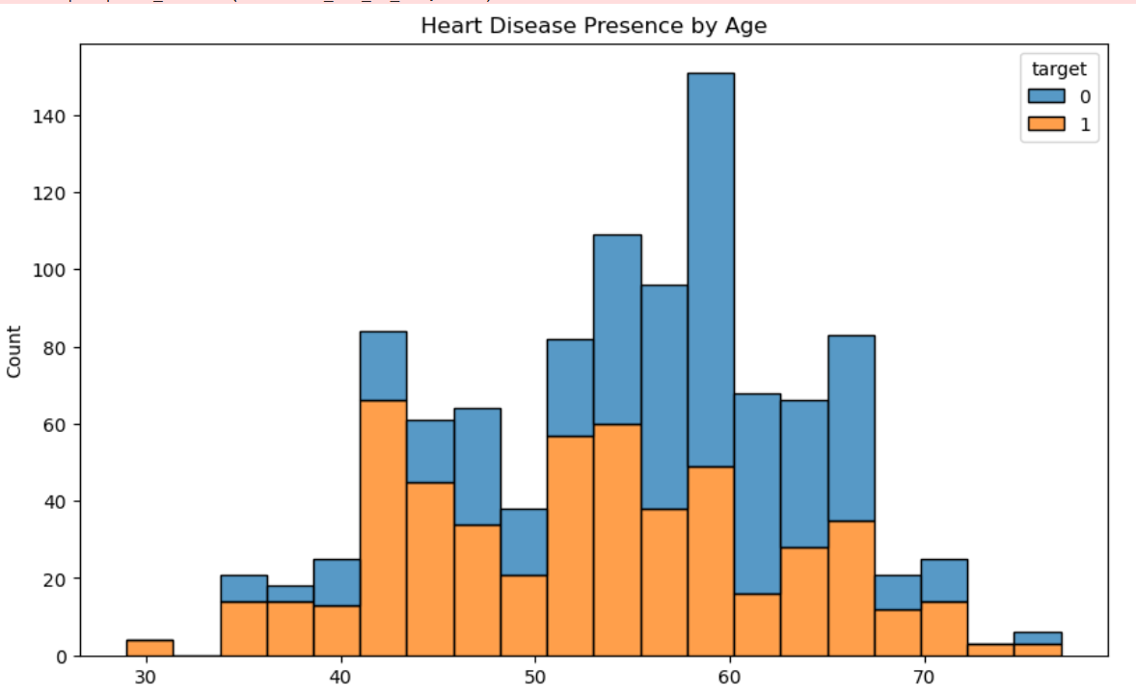
Presence Of Heart Disease By Age

Slide 7
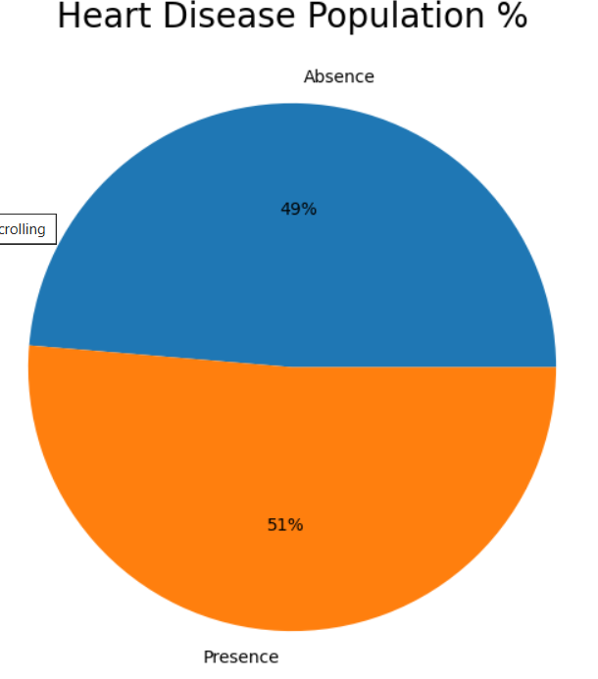
Heart Disease Population Percentage
It is found that 51% Males have heart disease and 49% females have heart disease.

Slide 8
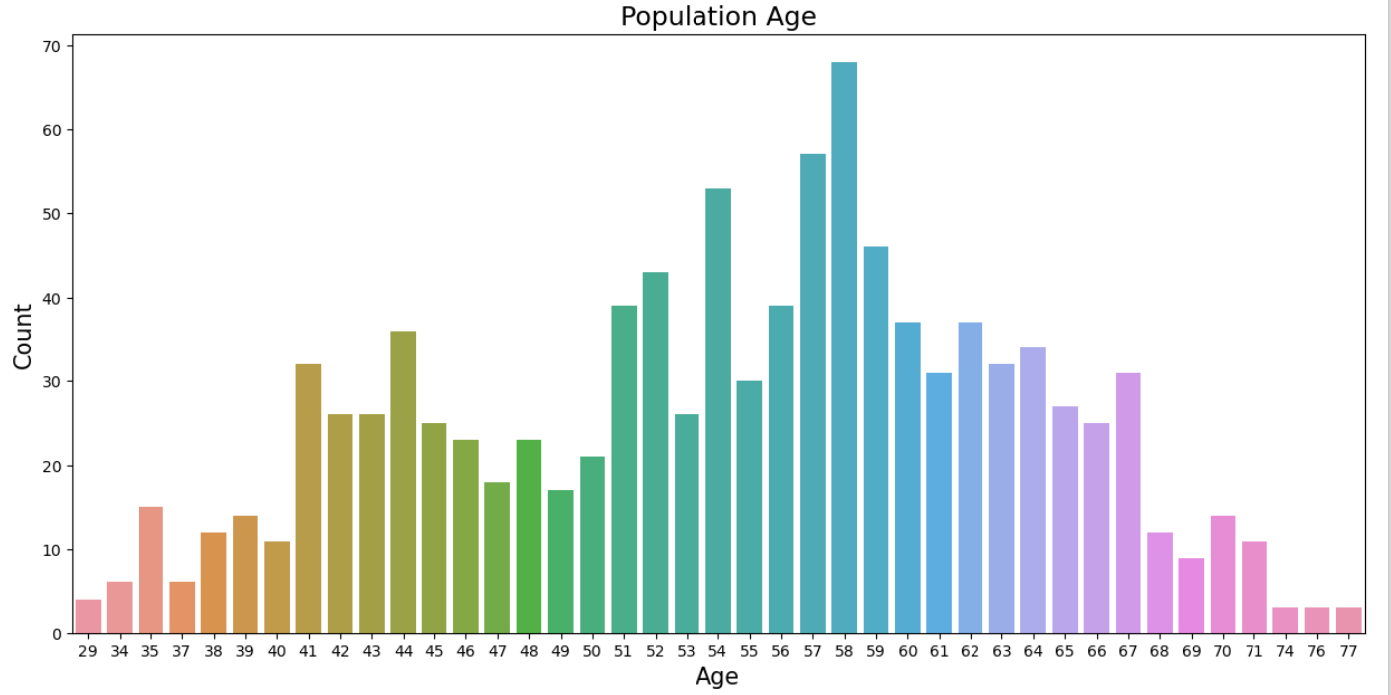
Population Age

Slide 9
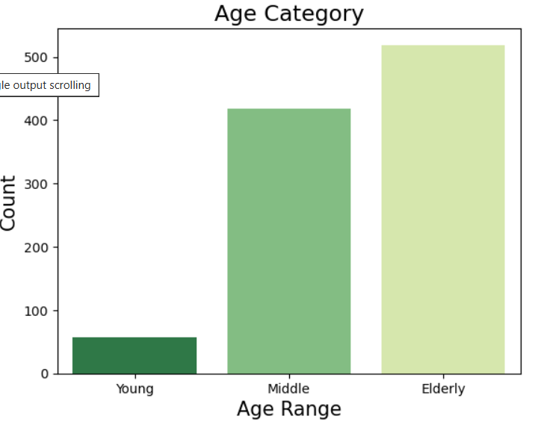
Disease According To Age Category
From the figure we can conclude that
Elderly aged people have more chances of heart disease while the young aged people have very less chances of heart disease.

